Slide 1
Shark tank
By: Jeronimo Carrascal
9B

Slide 2
Main idea
we can construct each other; we are all the same inside. Religion is in all of us.

Slide 3
Main object (Archival Object)

Slide 4
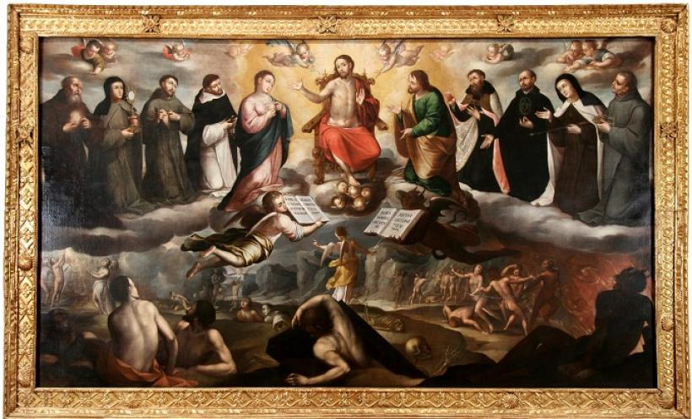
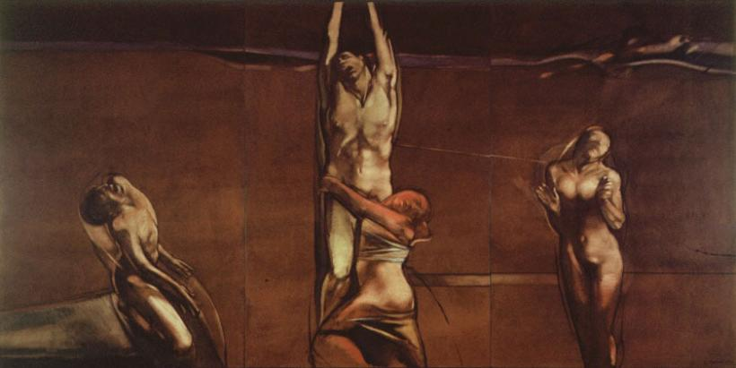
References (Archival/ Concept)
Gregorio Vazquez, Religious painter (1638-1711), Inspired many paints like, “La muerte de San Jose”
Luis Caballero (Contemporary artist)
1974, Luis Caballero
1673, Gregorio Vásquez, “El Juicio Final”

Slide 5
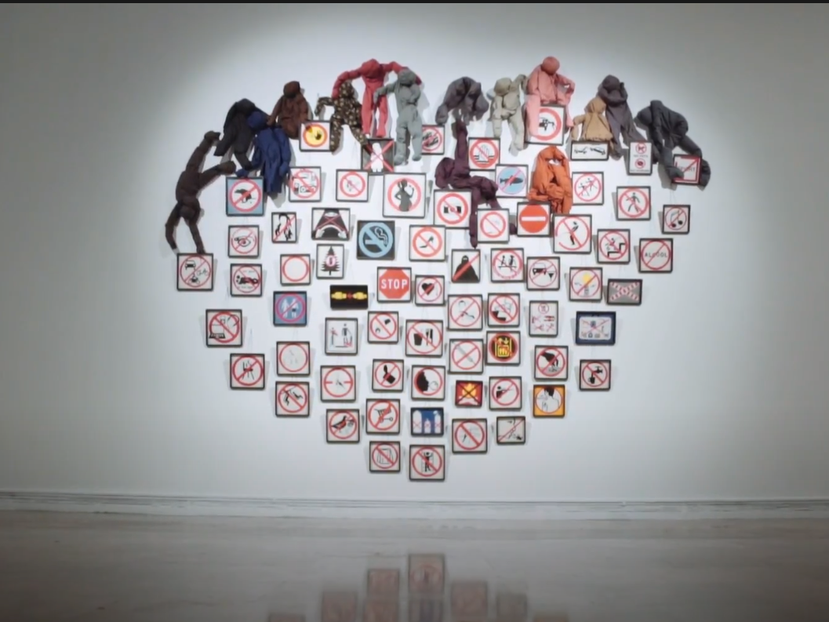
References (Body and Space)
Annette Messager, 2018

Slide 6
Sketch:

Slide 7
Objective:
I want to represent the same unión that this virgin brough to my familiy due that in all of us no matter our likes, or who we are religión Will always units us all.

